Slide 1
Industrial “Utopias” at the Turn of the Twentieth Century: Contested Landscapes for the Common Welfare
CHI Professionalization Workshop for Secondary Teachers on
Utopian Communities, April 30, 2016
Kathryn J. Oberdeck
Department of History
University of Illinois, Urbana Champaign

Slide 2
21st Century :Foreclosures and Homelessness

Slide 3
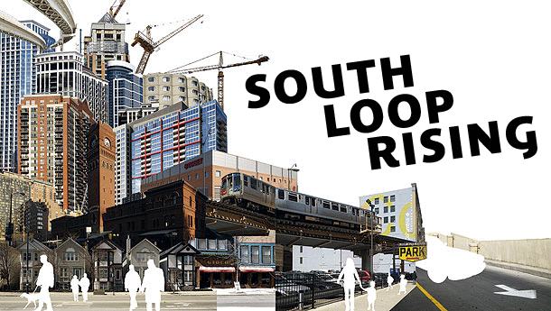
Gentrification
Chicago's West Loop 2007-2014

Slide 4
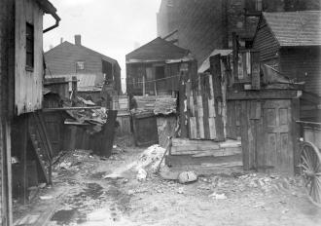
Lewis Hine, “Hull-House: Our Backyard”

Slide 5
Industrial Housing

Slide 7
Richard Ely on Pullman
http://urbanplanning.library.cornell.edu/DOCS/pullman.htm

Slide 8
Pullman: Arcade and Public Square

Slide 9
Pullman: Workers’ Row Houses

Slide 10
Pullman: Row House Floor Plan

Slide 11
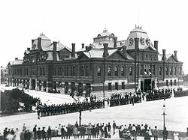
Pullman: Strike

Slide 12
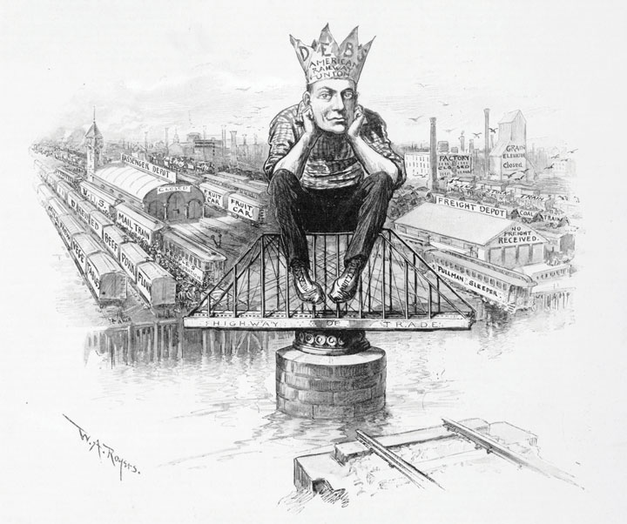
Pullman Strike, Eugene Debs and Socialism
a. Pullman Strike 1994
b. Socialist Party
--1901
Debs and 1894 Pullman Strike

Slide 13
Trade Unionism

Slide 14
Henry George and Single Tax

Slide 15
City Planning

Slide 16
Ebenezer Howard

Slide 17
The Three Magnets and Garden City

Slide 18
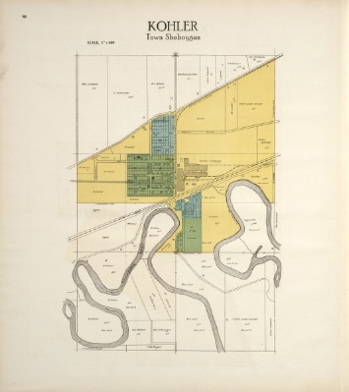

Slide 19
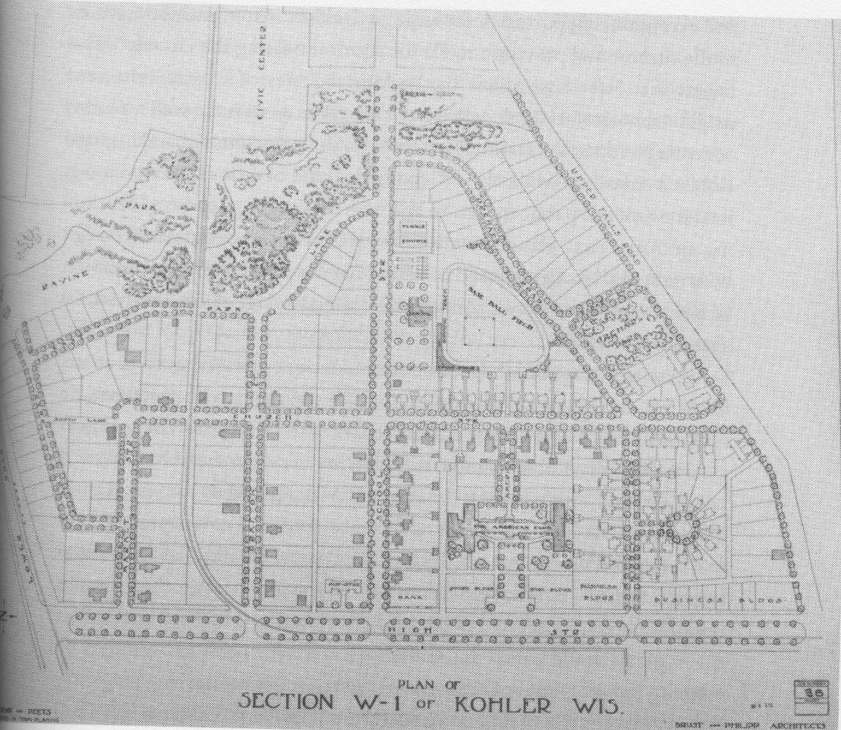

Slide 20
Kohler Village
http://catalog.hathitrust.org/Record/010979344

Slide 21
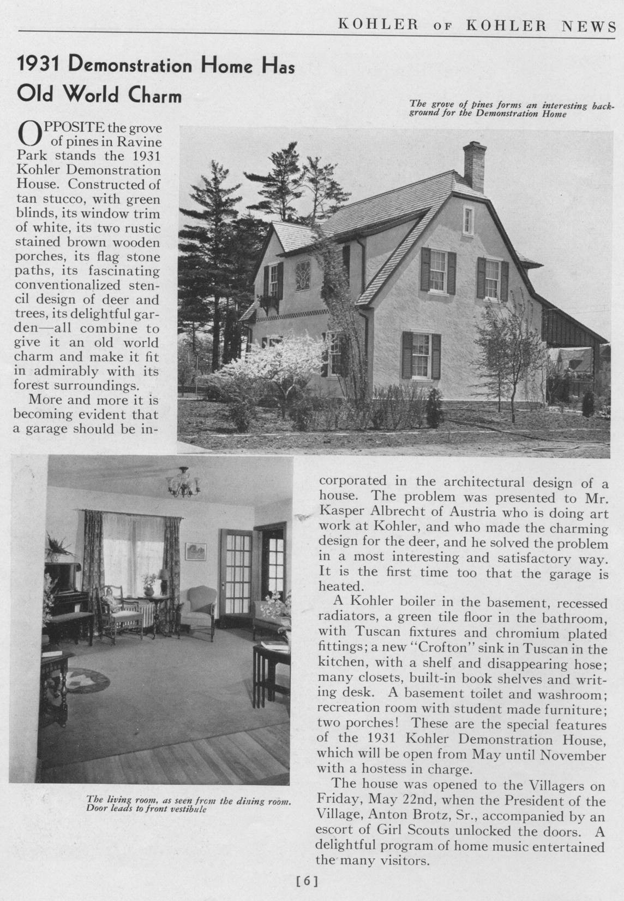

Slide 22
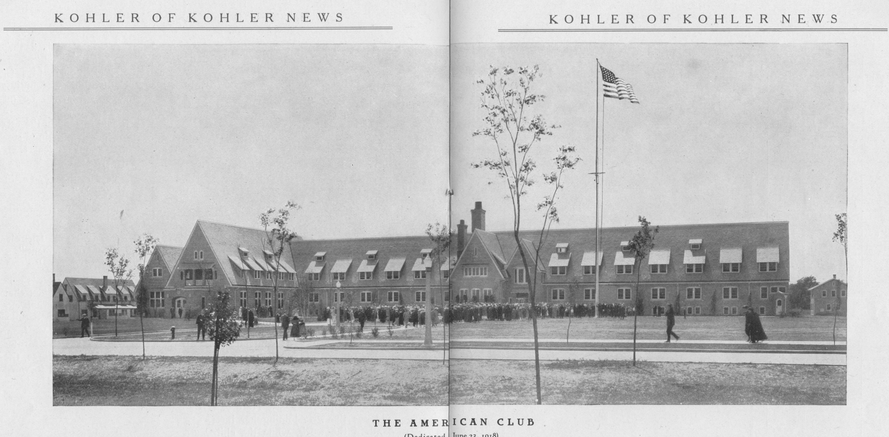

Slide 23
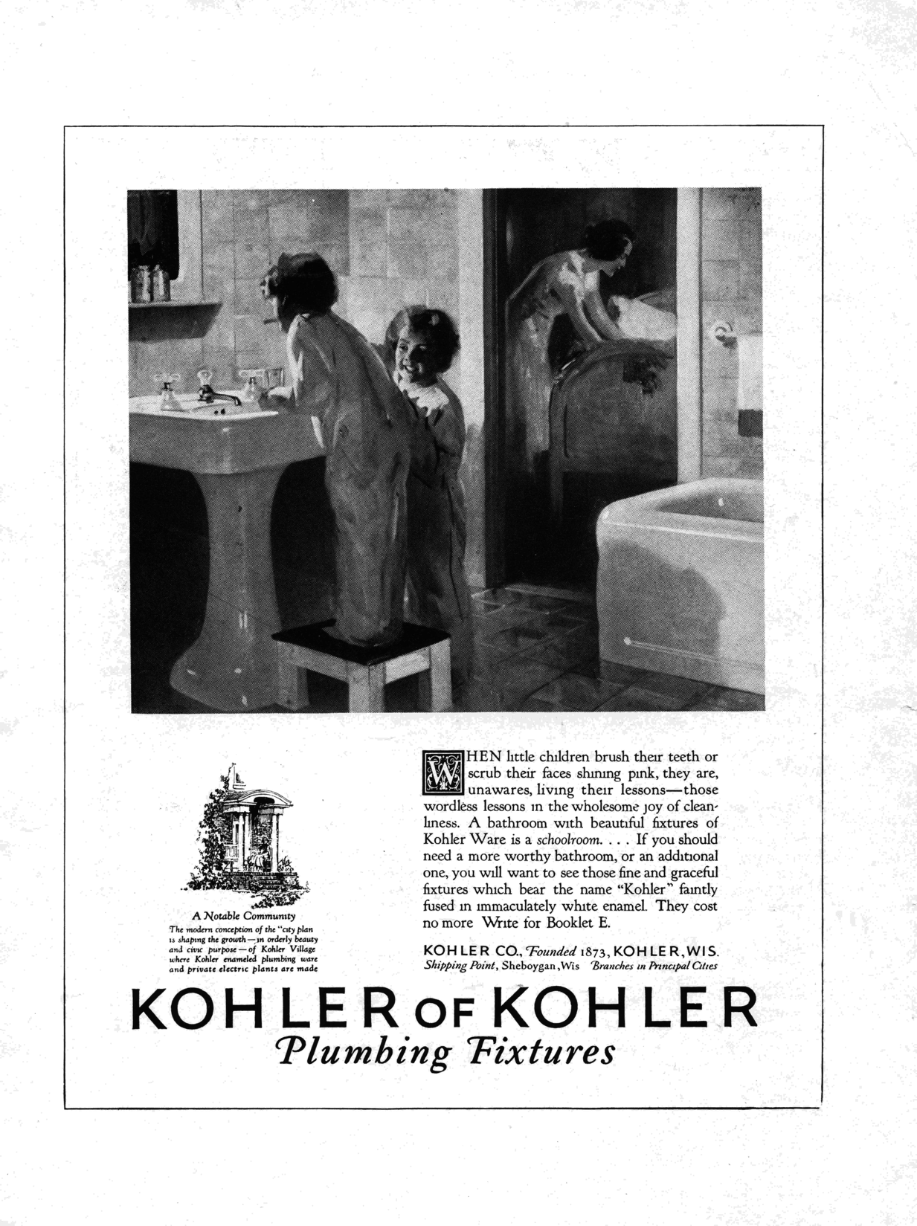

Slide 24
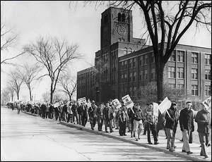

Slide 25
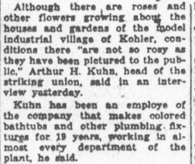

Slide 26
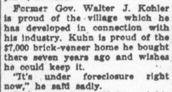
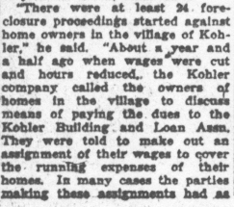
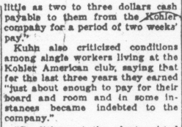

Slide 27
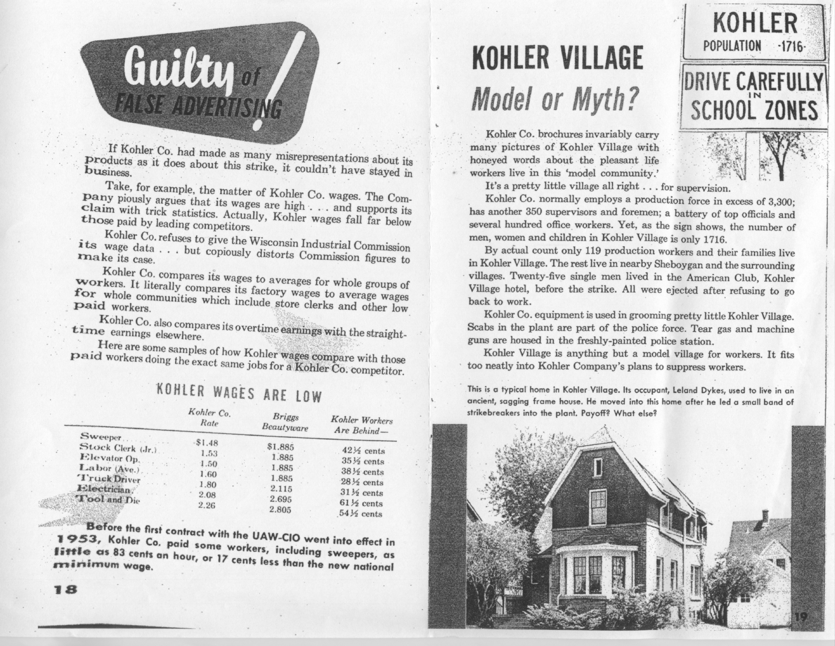

Slide 28
