Slide 1
«The Problem of Constructing Socialist Cities» Urban Utopianism in the Soviet Union
Center for Historical Interpretation Teachers Workshop Deirdre Ruscitti Harshman

Slide 2
“Strangification” as Teaching Method
Ostranenie
Emphasizes the idea of difference while making it understandable
De-naturalizes things that students see as familiar
Useful for topics that students see as removed, temporally or geographically
In this case, we will explore how we can use ostranenie as a way to complicate students’ understanding of three categories: utopia, cities and the role of housing, and the Soviet Union

Slide 3
Re-defining Utopia
Utopia not as opposite of dystopia
The “impulse” to “venture beyond” to the “not yet” (Bloch)
Creation of an ideal home
What desires do students have? How do their desires conflict with the desires of others (partners, city planners, landlords)?
How can we use the documents to look at what desires existed during the Soviet period?
How does this connect to the type of cities that emerge?

Slide 4
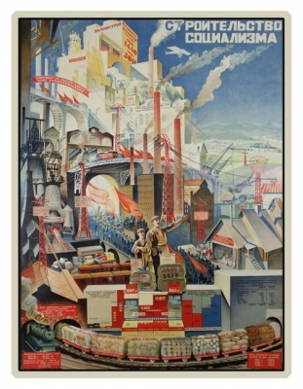
The City and Housing
What is the role of the city?
How is it consciously shaped to be different than capitalist cities?
How does this compare to students’ visions?
The role of space and imagination
“The building of socialism”

Slide 5
Soviet Cities as Utopian Community
When we look at how the Soviet Union is “moving beyond”, we most commonly look at politics, economics
The socialist transformation into the Soviet Union was meant to transform the everyday
Goal of records (civics)
Role of gender
Lived experience
“With every day, life becomes happier”

