Slide 1
Experiences of political reconciliation in South Africa
CHI Teachers’ Workshop
T. Barnes
4-30-16

Slide 2
How should society respond to violent acts of injustice, to try to achieve peace?
Retributive justice:
once a perpetrator is identified and convicted, they must be punished. Focuses on the individual’s guilt and on retaliation/ revenge against that person.
Restorative justice:
once a perpetrator is identified and convicted, activities are initiated that try to heal the wrongs that have been done. Focuses on building reconciled relationships and communities, and on regrowth.

Slide 3
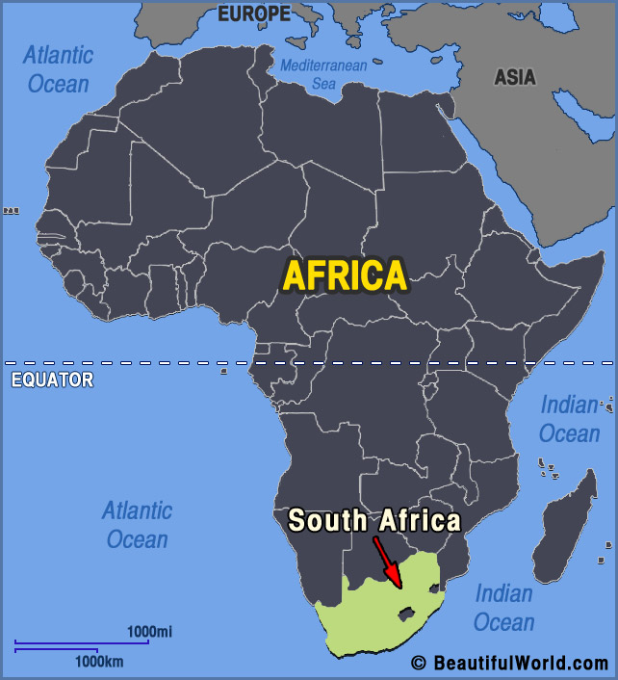

Slide 4
Periods of South Africa’s colonial history
Mid-17th century: first settlement by the Dutch
18th-19th centuries: more Dutch and British settlement; warfare dispossesses Africans of land and resources; slavery and indentured labor common; SA an economic backwater
1867; 1886: discovery of vast deposits of diamonds and gold transform the economy
20th century: warfare, segregation, apartheid and resistance
1994: first democratic elections, won by Nelson Mandela and the ANC (African National Congress)

Slide 5
Main features of South African life after WWII
Rise in organized power of groups and organizations dedicated to the promotion of white supremacy
Rapid industrialization
Population = 70% African, 17% white, 10% Coloured, 3% Asian
Growing population
Increasing rates of African urbanization

Slide 6
Main principles that emerged in the apartheid period, 1948-1994
Strict racial definition based on fear of “racial mixing”
Exclusive white participation in and control of government and state institutions
Separate territories for black life
Strict spatial segregation in the towns and cities
Tight racial division in labor markets
Segregation of amenities, facilities, and economic and educational opportunities of all kinds

Slide 7
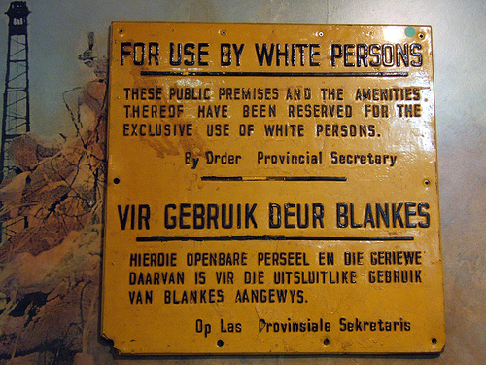

Slide 8
Fighting against dispossession, segregation and apartheid
Wars against Dutch and British settlers 17-19th centuries
Mission-educated Africans work for equality, 1910-1940s
1950s, younger generation initiates civil disobedience campaigns
1960s, little visible activity but exile organizations grow in strength
1970s, strikes and urban rebellions of students
1980s, “make South African ungovernable” – martial law and widespread violence
1990s, negotiations and majority elections in 1994

Slide 9
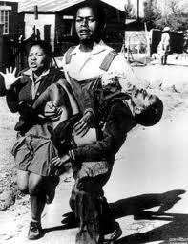
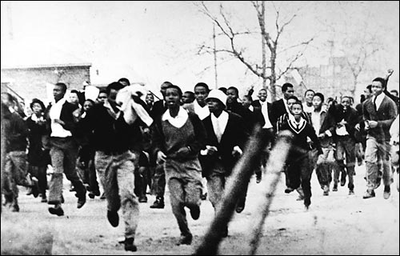
The Soweto Uprising, June 1976

Slide 10
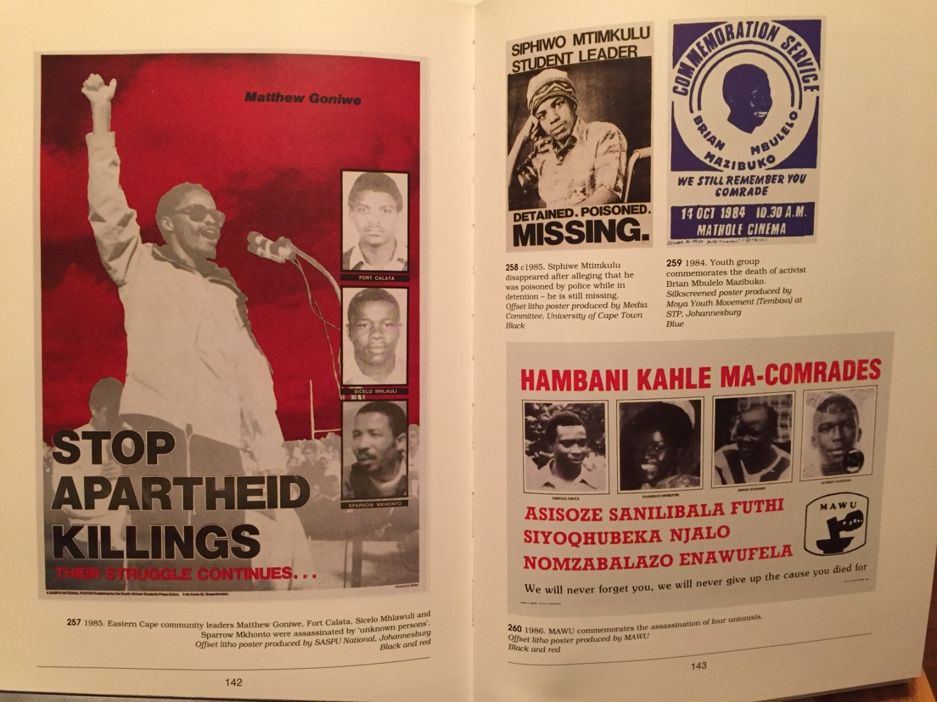
Resistance to apartheid and the state’s violent response, 1980s
From: South African History Archive, Images of Defiance: South African Resistance Posters of the 1980s (Johannesburg: STE Publishers, 2004)

Slide 11
“We will never forget you, we will never give up fighting for the cause you died for”

Slide 12
Convention for a Democratic South Africa, 1990-93:
multiparty negotiations about
the shape of a new government
minority rights
establishment of an assembly to write a new constitution
mechanism to address politically motivated crimes of the past
The settlement included guarantees for and concessions to all sides.
Elections were held in April 1994. The ANC won 62% of the vote, formed a new government. Nelson Mandela became the first president of democratic South Africa.

Slide 13
The Truth and Reconciliation Commission (TRC, 1995-98) in South Africa – a contested process, born from political compromise, asked these questions:
What are the legacies of political and social violence and how should they be addressed?
How can victims of atrocities deal with desires for justice and/or revenge?
What constitutes fair and appropriate compensation to victims of war and violence?
Is reconciliation a personal or a national matter?
How should apartheid be remembered – whose memories are important?
How are truth, reconciliation and justice connected?

Slide 14
The TRC sought to answer these questions by:
1. Investigating and documenting human rights abuses,
2. Considering the granting of amnesty to perpetrators of human rights abuses and
3. Considering the payment of reparations to the victims of human rights abuses.
The TRC focused on the actions of individuals, not on social institutions.
It was scheduled to run for 3 years with a budget of about $40 million; it had a staff of 300 people and four main offices around the country.

Slide 15
Significant human rights violations or acts NOT investigated by the TRC and so not included in the final report:
The forced removal and displacement of millions of people based on race
Gross human rights abuses committed before 1960
Everyday policies and practices of apartheid that did not result in killings, abduction, torture, or severe ill-treatment as defined by the commission
The actions of social institutions in line with apartheid ideology: social services, education, business, health care, private employment

Slide 16
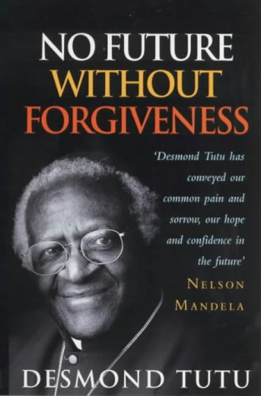
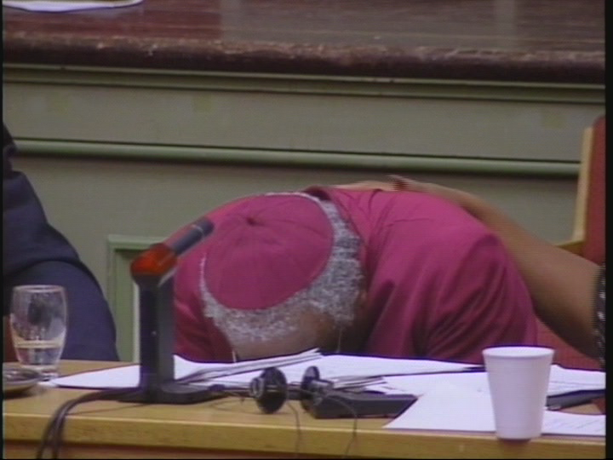
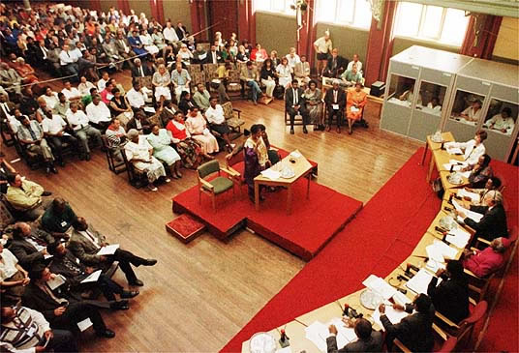
The primary objective was to preach forgiveness in order to heal the emotions and wounds of hatred or anger created by the apartheid system. There was no place for retaliation in the new society. It was envisaged that "one who forgives becomes a better person than the one being consumed by anger and hatred.“… but forgiveness also required acknowledgement on the part of the perpetrator that they had committed an offence.

Slide 17
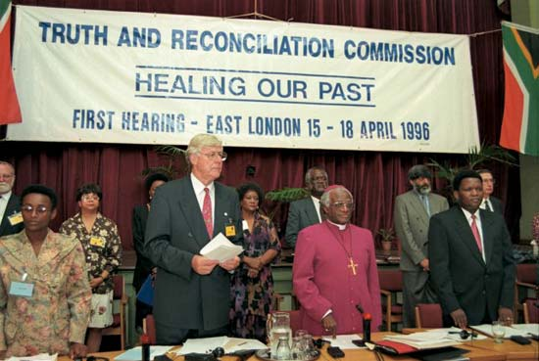
1996-98
Hearings begin in April 1996 amid a swarm of international television cameras. In the hearings that follow, chaired by Archbishop Desmond Tutu, victims of the apartheid authorities, their widows and their mothers, often broke down in tears as they gave their testimony. 21,000 testimonies from victims and witnesses.
The commission officially ended its work in July 1998 after more than two years of hearings and investigations.
The first three volumes of Commission’s final report were published in October 1998; four more appeared by 2003.

Slide 18
Truth: Documentation of human rights abuses in the 7 volume Final Report
Killings by state agents inside and outside South Africa; lists of the names of the dead
Disappearances
Torture and abuse by police and armed forces
Raids into neighboring countries to attack opposition forces
Killings, by bombs and land mines, by the armed opposition
Abuses in detention camps by the armed opposition outside South Africa’s borders
Violence by private individuals for political reasons

Slide 19
Reconciliation: Amnesty (program concluded in 2001)
The TRC received 7,100 applications for amnesty. Only approx. 2,000 of these applications were granted.
Grounds for a successful application:
Proportionality of the act
Full disclosure of the circumstances of the act
Only acts of political violence, not criminal (for personal gain or animus) violence were eligible
Amnesty exempted individuals from criminal prosecution and civil damages suits for those acts.
Many people who applied were already in prison
Senior members of the apartheid gov’t did not apply for amnesty, maintaining that they had not committed any crimes.
Amnesty hearings that did occur provided new details about operations, targets, forms of brutality and torture and details about who had given orders or knew about these acts.

Slide 20
Reconciliation: Reparations (program concluded in 2003)
Interim emergency reparations were paid to 2,500 people by 1998 in amounts ranging from $300-$1,000
In 2003, 22,000 people who had applied and were designated as victims of gross human rights abuses eventually received monetary payments of approximately $4,000 each (= approx. 3 years salary for a domestic worker). 25,000/40 million = .0625%
Research by the Khulumani Support Group has shown that reparations were spent by people living in debt and poverty on necessities such as food, rent and children’s school fees; there were family disputes over the money; and recipients generally were not been able to invest, start new enterprises or make lasting contributions to more stable economic status.
khulumani.net

Slide 21
What about criminal prosecutions of people who were not granted amnesty?
Out of the millions of white South Africans who benefited from apartheid, and the thousands of policemen, soldiers, and bureaucrats who masterminded, oversaw and carried out acts of terrible violence against ordinary people and anti-apartheid activists of all races, how many have been criminally prosecuted and sent to prison?

Slide 22
Eugene de Kock (1949 - ), “Prime Evil” and Vlakplaas farm
Policeman, promoted to head of secret Vlakplaas death squads.
One of the few apartheid commanders who spoke to the TRC. De Kock admitted his guilt. Although he was granted amnesty for some murders, he was sent to prison for others with a sentence totaling 212 years.

Slide 23
Justine van der Leun, “The odd couple: why an apartheid activist joined forces with a murderer,” The Guardian 6 June 2015 http://www.theguardian.com/global/2015/jun/06/odd-couple-apartheid-activist-madeleine-fullard-convicted-policeman-eugene-de-kock
“Over the years, De Kock and his men bombed ANC offices, slaughtered a family of five in Botswana, and a group of eight in Lesotho (including a husband and his unarmed wife, whose one-year-old daughter was left alive and alone next to her dead mother). They blew up the car of their own black police colleagues, whom they suspected of double-crossing them. They ambushed and slaughtered three student activists, and sent a young lawyer a bomb hidden in a cassette player, which took off his head while he sat at home with his wife. They kidnapped an apolitical security guard, tortured him for information on his guerrilla brother, and, realising he knew nothing, bashed in his head with a shovel and hid the body. With De Kock at the helm, a small group branched out and began to deal in weapons, supplying conservative black groups fighting the leftwing ANC with guns and grenades, causing untold bloodshed in the townships.”

Slide 24
“We will never forget you, we will never give up fighting for the cause you died for.”
“Phineas Sibiya was chairperson of the Sarmcol shopstewards, a leader of the cooperative movement and a MAWU regional worker leader. Simon Ngubane was a Sarmool shopsteward, a leader within the cooperative's cultural wing and leading performer in the Sarmcol play. Florence Mnikathi was a Sarmcol health committee activist and a daughter of one of the Sarmcol strikers. Alpheus Nkabinde was a youth activist in Mpophomeni.
On December 5, Phineas, Florence, and Simon were abducted from the township of Mpophmeni and brutally murdered. On that same night Alpheus was killed in the township. The entire community was shaken and together with the union struck with grief and anger. Union leaders alleged that those responsible for the killings were vigilantes led by Inkatha sympathisers and occupying the local community hall in Mpophomeni during that night. The Bureau of Information in a statement issued soon after the killings confirmed the involvement of Inkatha sympathisers in the killing. The police, perched on buses, and threatening to shoot teargas at the angered community,
escorted the suspects out of Mphophomeni the following morning.”
www.disa.ukzn.ac.za/.../LaJan87.0377.5429.012.002.Jan1987.4.pdf

Slide 25
De Kock after 1996:
In prison, he met with people searching for the truth or truths about South Africa’s violent past: psychologists like Pumla Gobodo-Madikizela, and TRC investigators looking for answers about people who had disappeared in the apartheid years
Met with many victims’ families and apologized. Many of them (but not all) then support his repeated requests for parole
Was granted parole and released in 2015
Current whereabouts unknown

Slide 26
So, how can we use the South African example to teach about reconciliation and the quests for social peace?
Encourage students to think about and discuss the differences between retributive and restorative justice by asking questions like:
Was/is Eugene de Kock a monster?
Should he have been released from prison?
Why did the families of some of his victims support his release?
Should Gobodo-Madikizela have visited him in prison?
What is the stance of the US justice system in regard to retributive vs. restorative justice?

Slide 27
6. How can the memory of those who died be maintained?
7. Should the government pay for memorials, or should it be the responsibility of individual families?
8. Does remembering (“we will never forget you”) promote a better world in the future? Or does forgetting the wounds of violence make more sense?

Slide 28
Books for younger readers on South African history

Slide 29
…and on restorative justice

Slide 30
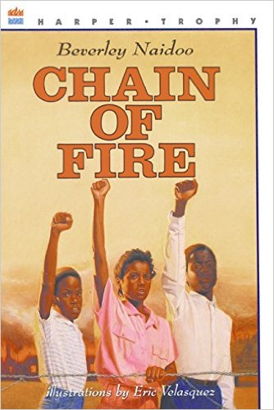
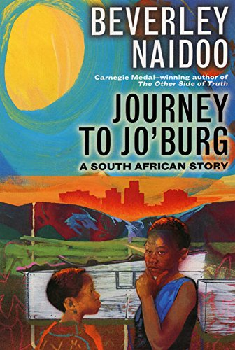
Books for older readers about everyday life and resistance in the apartheid period

Slide 31
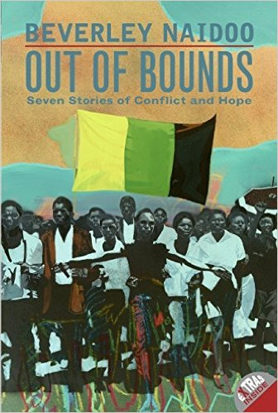
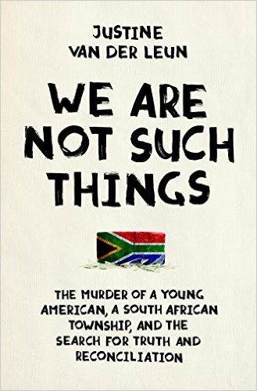
…and about restorative justice

Slide 32
Films for older students about the TRC
http://africasacountry.com/2012/02/south-africas-trc-on-film/
http://www.irisfilms.org/films/long-nights-journey-into-day/
http://guides.library.cornell.edu/winnie/truth

Slide 33
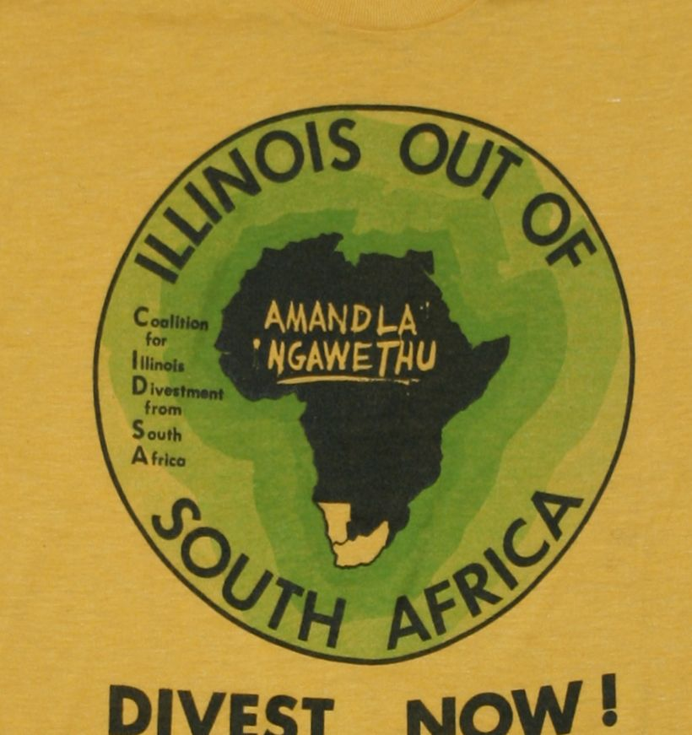
And a new resource on the local anti-apartheid struggle, Urbana Free Library
https://www.flickr.com/photos/98945443@N05/15674229083/in/photostream/

