Slide 1
The Significance of Environmental Justice in American History: An Introduction
Bob Morrissey, Department of History, UIUC

Slide 2

Environmental Justice
Environmental justice is the fair treatment and meaningful involvement of all people regardless of race, color, national origin, or income, with respect to the development, implementation, and enforcement of environmental laws, regulations, and policies.

Slide 3
Environmental Justice Elaborated:
equitable distribution of environmental risks and benefits
fair and meaningful participation in environmental decision-making for all groups
recognition of community ways of life, local knowledge, and cultural difference in environmental decision-making

Slide 4
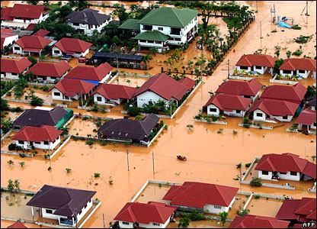
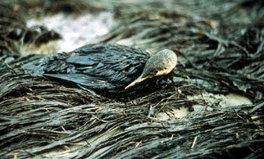
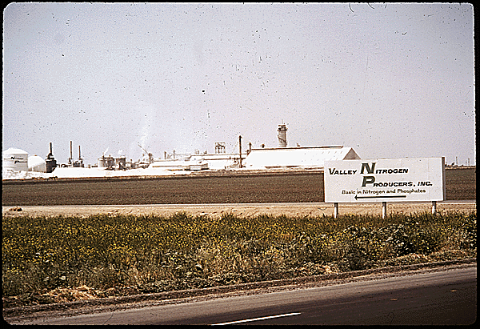
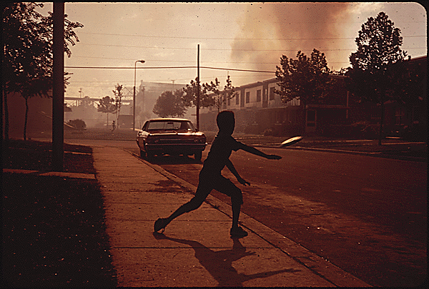
Examples you know of in the history of EJ?

Slide 5
Why is EJ important in American History?
In U.S. history, “it’s not simply that people have exploited nature; they have exploited other people to exploit nature.” – Richard White
Many environmental changes and policies in American history have disproportionately affected and impacted certain groups
EJ is a great lens through which to understand the sweep of American environmental history. If you start with the premise that EJ is an important value, then the past imposes a great burden.

Slide 6
Another Reason: EJ and Environmentalism
Environmentalism: “broad philosophy, ideology, and social movement regarding concerns for environmental protection and improvement of the health of the environment, particularly as the measure for this health seeks to incorporate the concerns of non-human elements.”
“Environmentalism advocates the lawful preservation, restoration and/or improvement of the natural environment, and may be referred to as a movement to control pollution or protect plant and animal diversity” –Wikipedia, accessed May 9 ,2017.
Environmental Justice is a great lens through which to view the history of the movement, “Environmentalism”

Slide 7
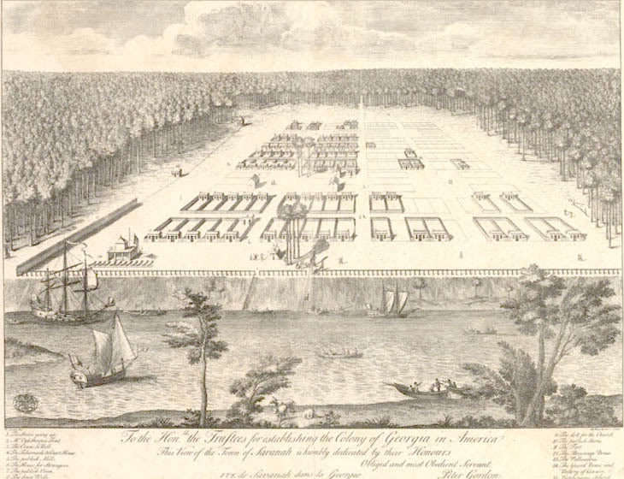
The History of Environmentalism

Slide 8
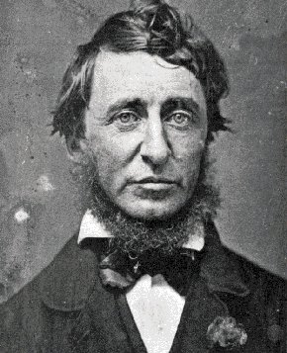
The History of Environmentalism

Slide 9
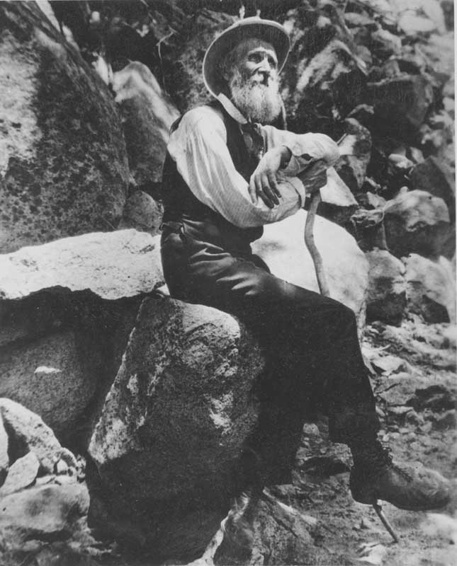
The History of Environmentalism

Slide 10
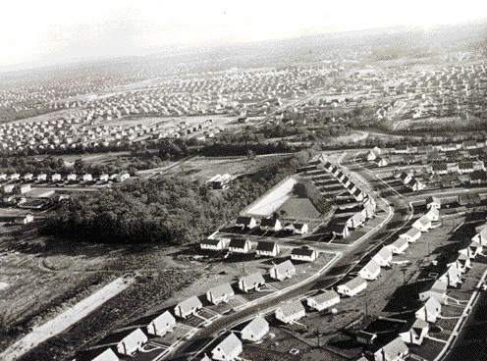
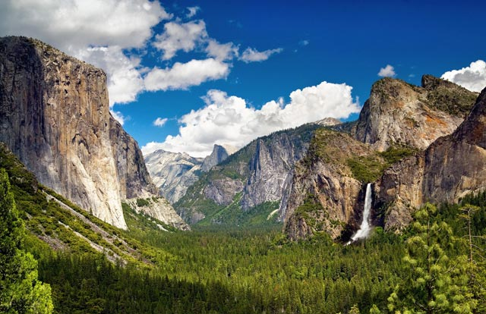
The History of Environmentalism

Slide 11
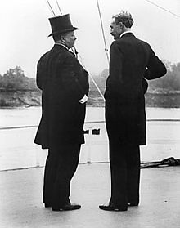
The History of Environmentalism

Slide 12
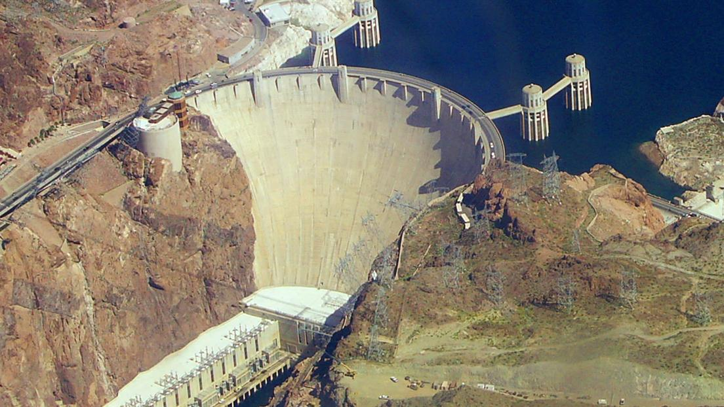
The History of Environmentalism

Slide 13
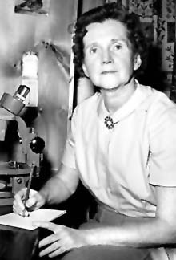
The History of Environmentalism

Slide 14
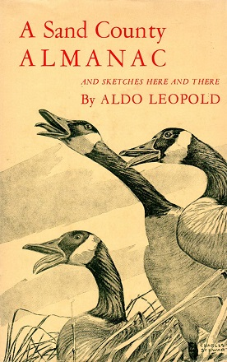
The History of Environmentalism

Slide 15

The High Water Mark: 1970

Slide 16
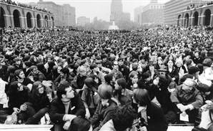
Earth Day
Gaylord Nelson, US Senator from Wisconsin
Denis Hayes, Grad student at Harvard
April 22, 1970
100,000 people in NYC
Estimated 20 million participants nationwide

Slide 17
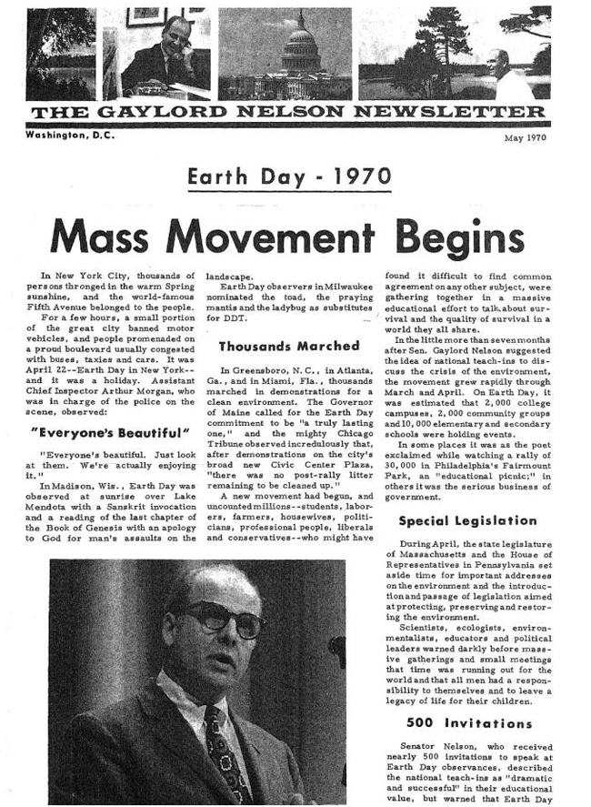

Slide 18
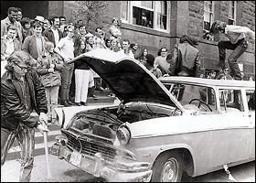
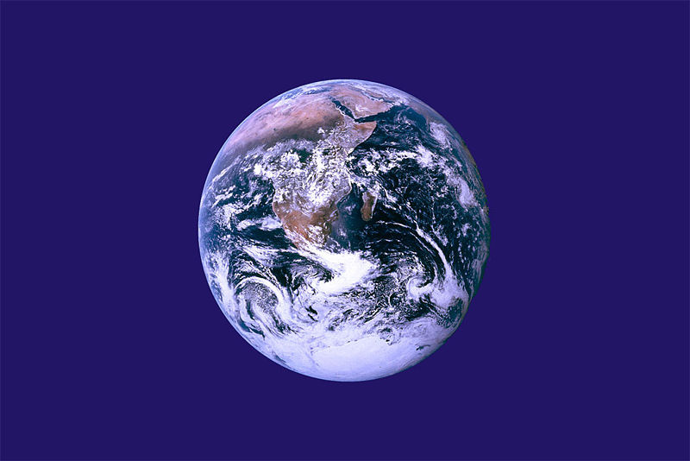

Slide 19
Earth Day’s Impact
Clean Air Act, 1970
  Set National Ambient Air Quality Standards
Water Pollution Control Act, 1972
  For the first time, legally blocked the discharge of wastes directly into rivers and lakes—this had been standard practice for centuries.
Federal Insecticide, Fungicide, and Rodenticide Act , 1972
RCRA, 1976 Resource Conservation and Recovery Act
  to deal with solid waste and especially hazardous wastes—defined wastes according to irritability, corrosivity, toxicity, reactivity, flammability, degradability

Slide 20

The Big One:
National Environmental Protection Act (NEPA), 1970:
    Created EPA, an independent regulatory and enforcement agency, whose director reports directly to the president. Also established the requirement of doing Environmental Impact Statements.

Slide 21





The Momentum and the Big 10
Major Environmentalist organizations
  Wilderness Society
  Sierra Club
  Nature Conservancy, 1951
  Conservation Foundation, 1948
  Resources for the Future, 1953
  Environmental Defense Fund, 1967
  National Resources Defense Council, 1970
  Greenpeace USA, 1971
  Sea Shepherd Conservation Society (1977)

Slide 22
It is easy to tell a heroic story about Environmentalism…

Slide 23
But where is Environmental Justice in All This?

Slide 24
But where is Environmental Justice in All This?

Slide 25
The answer is that it might be missing. Environmentalism has a great and important history; but it also has a blind spot. Too often the environmental pioneers missed questions of justice and equity. And this is a good way to rethink our understandings of the movement, and its legacy.
To do this, we could look at a lot of things: when I was in Tennessee, I taught about the TVA and environmentalists’ effort to save the snail darter, while ignoring the truly toxic things that the TVA was doing to local communities.
But today we can look at a closer example: Gary, the nearest place with a national park. Importantly, a national park first created in 1966, right around the high water mark of environmentalism. It was a great fight and a great victory. But interestingly, Gary is also the place with some of the most profound pollution problems in the U.S..
My point is not to take away from environmentalism and its heroes, but to challenge us to think about the oversights of what often gets considered a completely heroic movement. Environmentalism claimed to speak for one and all; to represent the mainstream public interest. But who did it really represent?

Slide 26
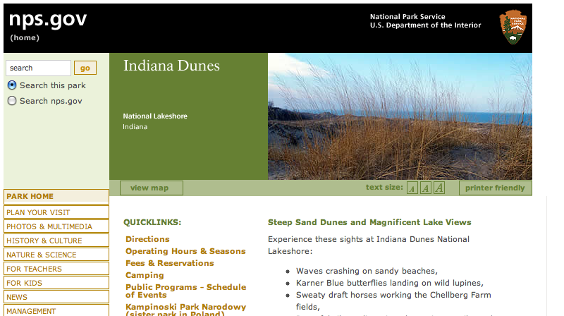

Slide 27
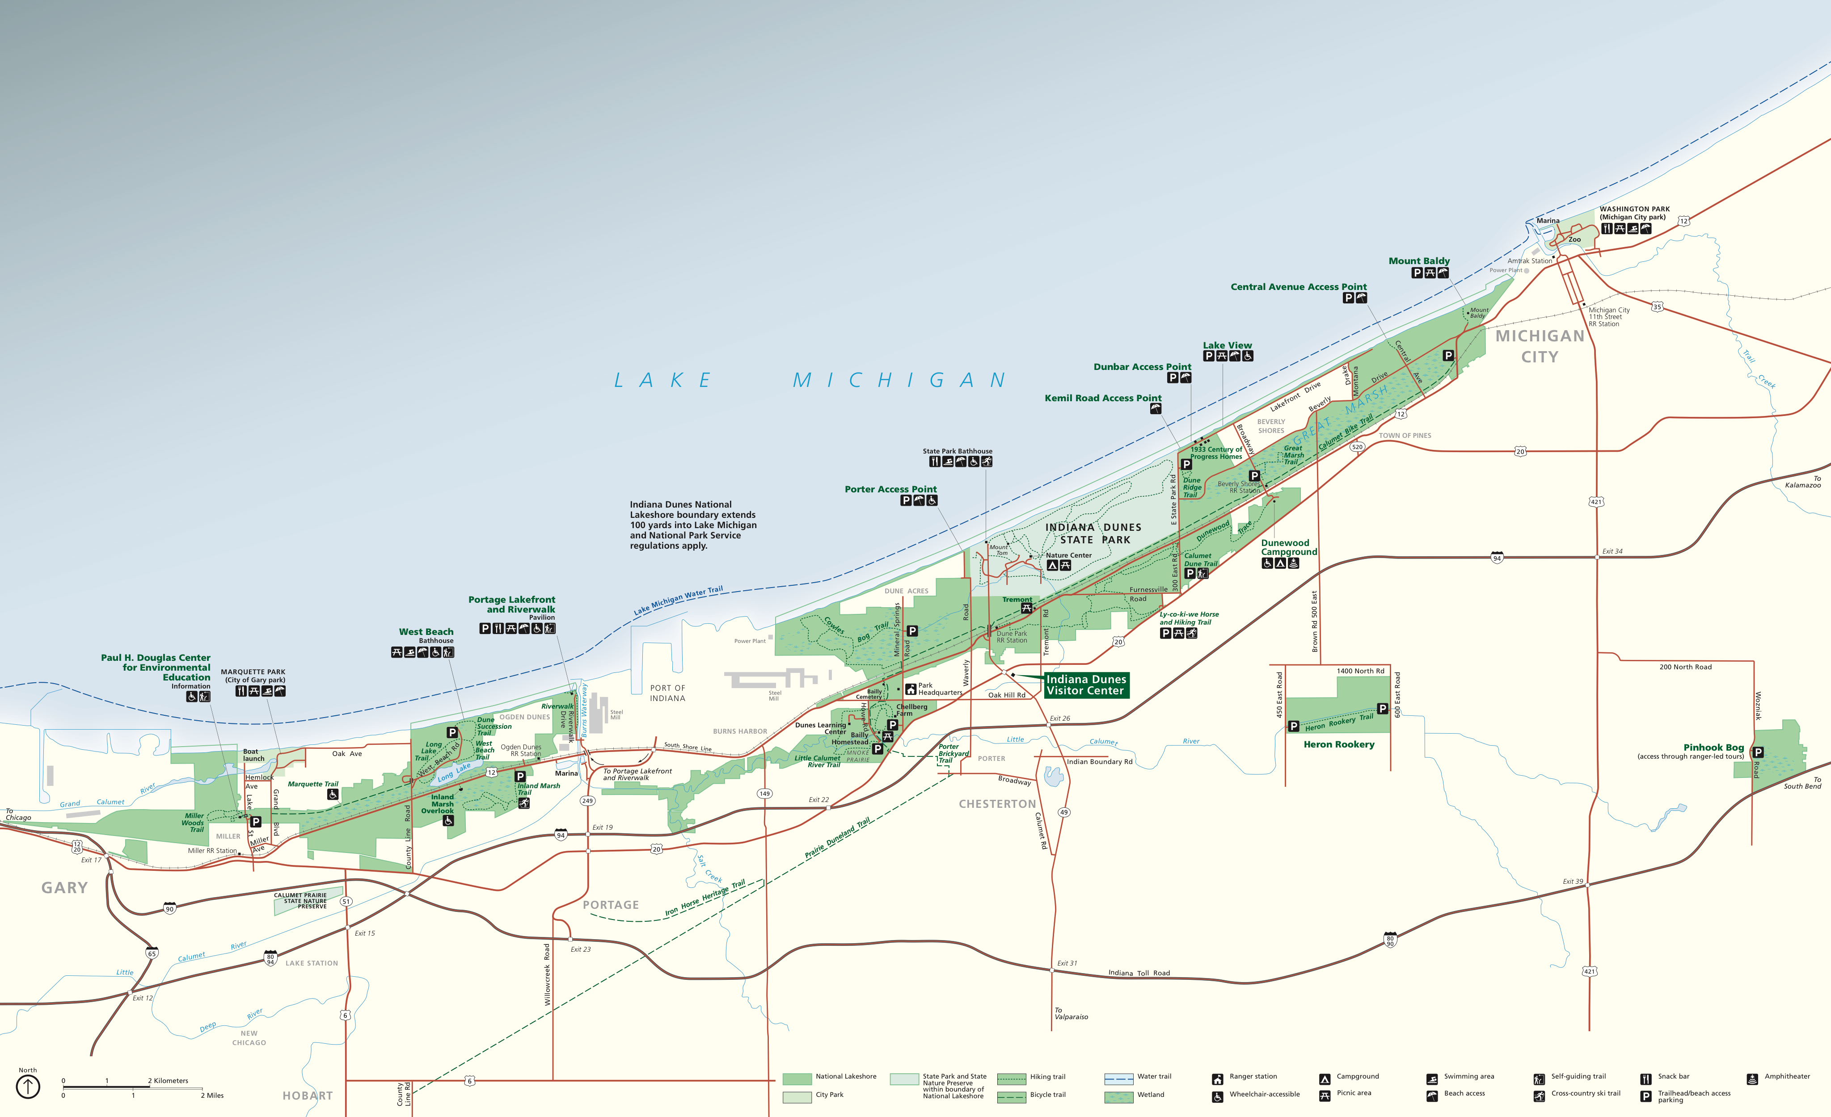

Slide 28
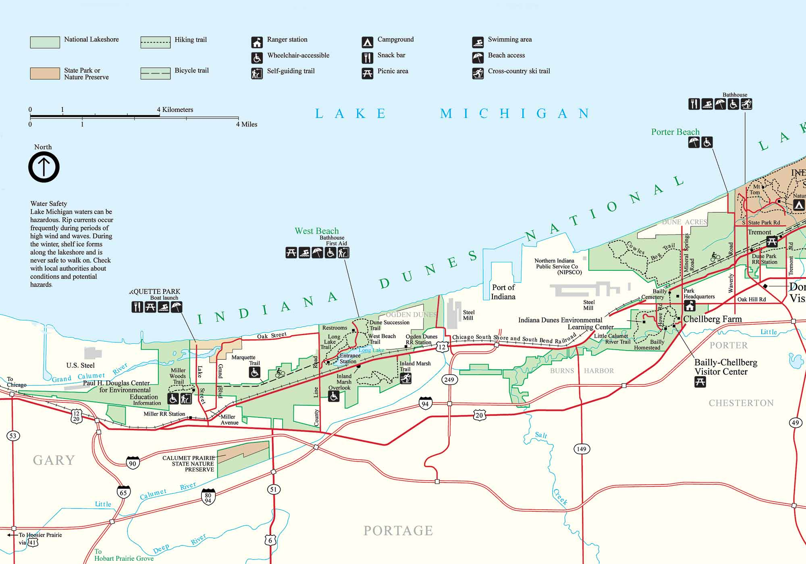
West side of the park

Slide 29
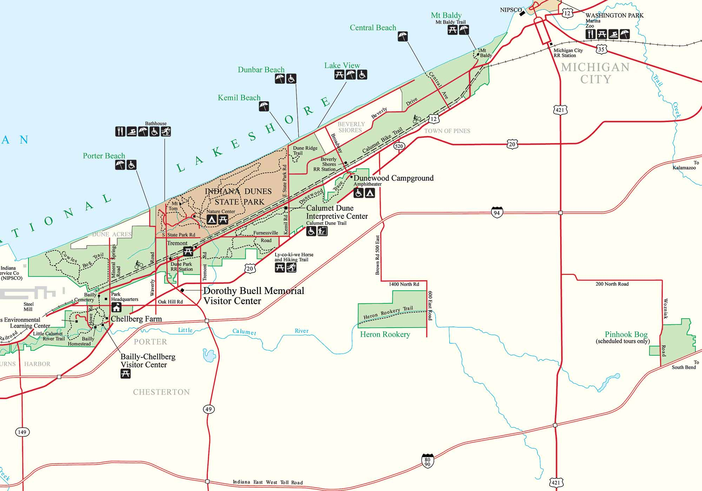
East side of the park

Slide 30
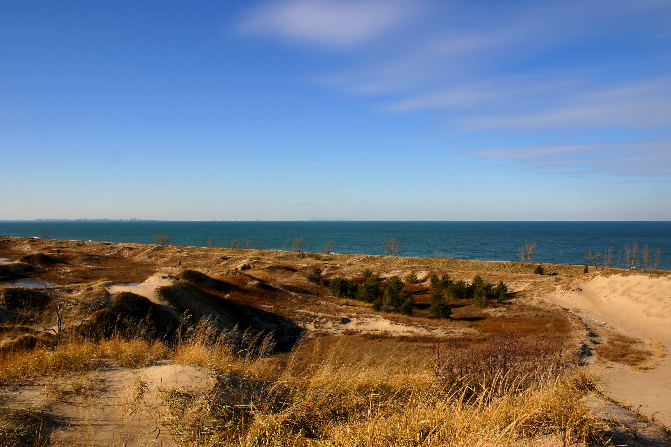

Slide 31
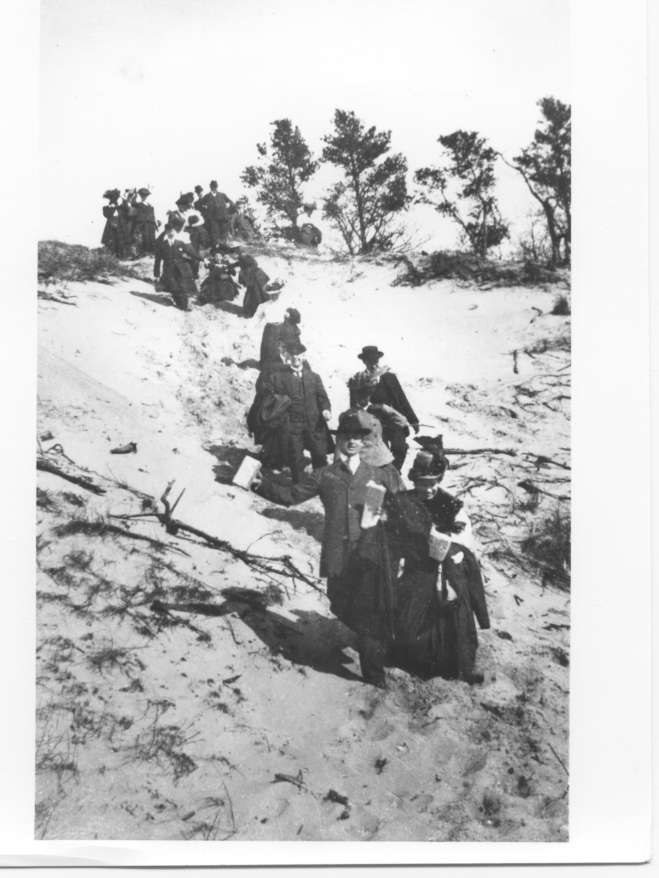
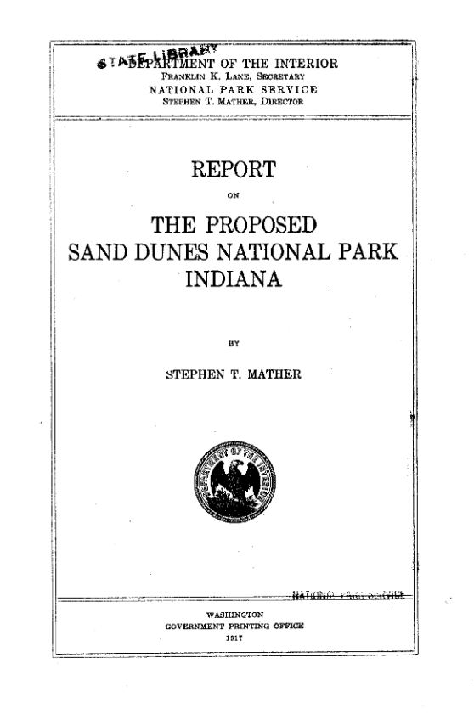
Early Preservationists at the Dunes

Slide 32
History of Dunes National Lakeshore
1900s: Chicago hikers began writing about the dunes, and painting “romantic” wilderness paintings, drawing attention to sublime beauty
1917: NPS Director Stephen Mather envisioned a park
1930s: Henry Chandler Cowles, founder of modern-day ecology, built research station in what is now Dunes National Lakeshore
1950: Port of Indiana development spurred action; Save the Dunes Council founded by Dorothy Buell
1960s: Illinois Senator Paul H. Douglas leads legislative push to create the park.
1966: Park founded. Expanded in 1976, 1980, 1986, 1992 thanks to activism by Save the Dunes Council.

Slide 33
Meanwhile…

Slide 34
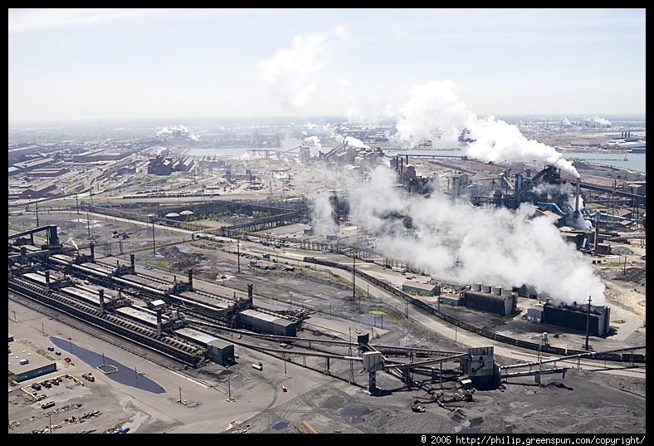

Slide 35
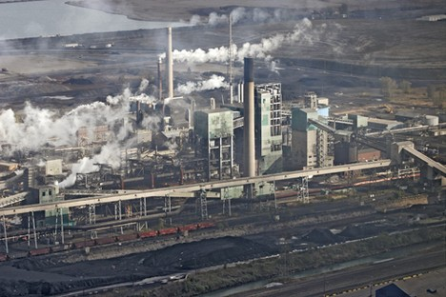

Slide 36
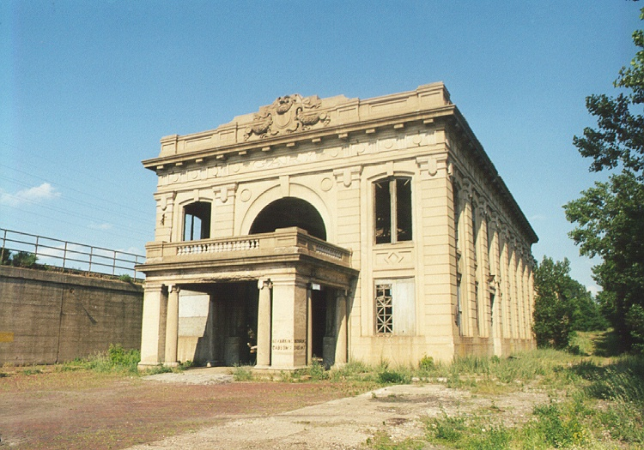

Slide 37
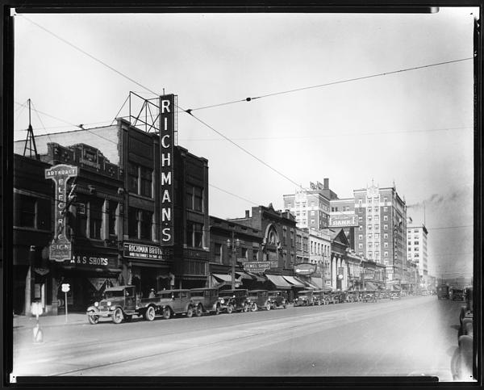

Slide 38
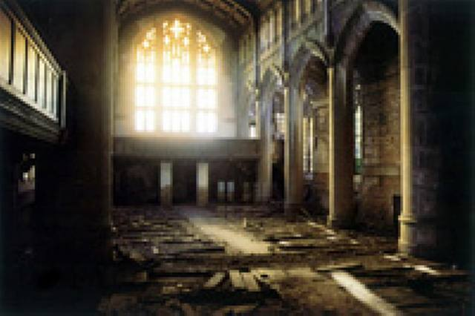

Slide 39
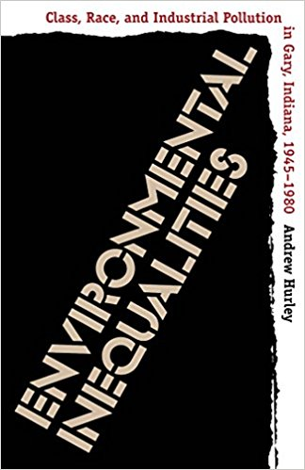
Andrew Hurley, Environmental Inequalities: Class, Race, and Industrial Polution in Gary, Indiana, 1945-1980

Slide 40
Environmental Inequalities
1980s: United Church of Christ leader Benjamin Chavis forms Commission for Racial Justice
“Toxic Wastes and Race in the United States”
Findings:
  3 out of 5 Black and Hispanic communities live in areas with one or more toxic waste dumps
  > 15 million Blacks, >8 million hispanics, >50% of Native Americans live in communities with abandoned or uncontrolled toxic waste sites
  S0^2 in Gary inner neighborhoods at triple EPA levels in 1980.

Slide 41
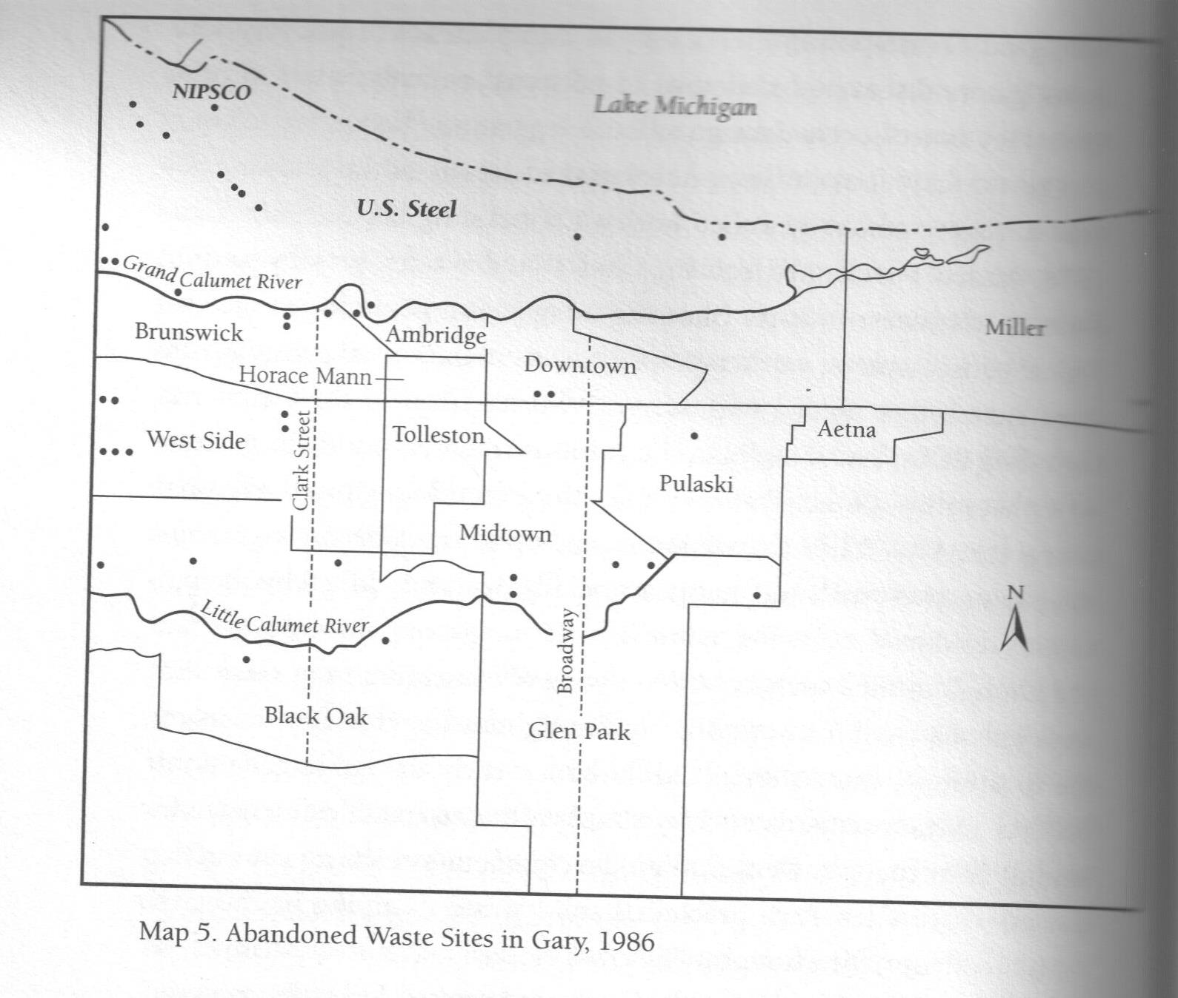

Slide 42
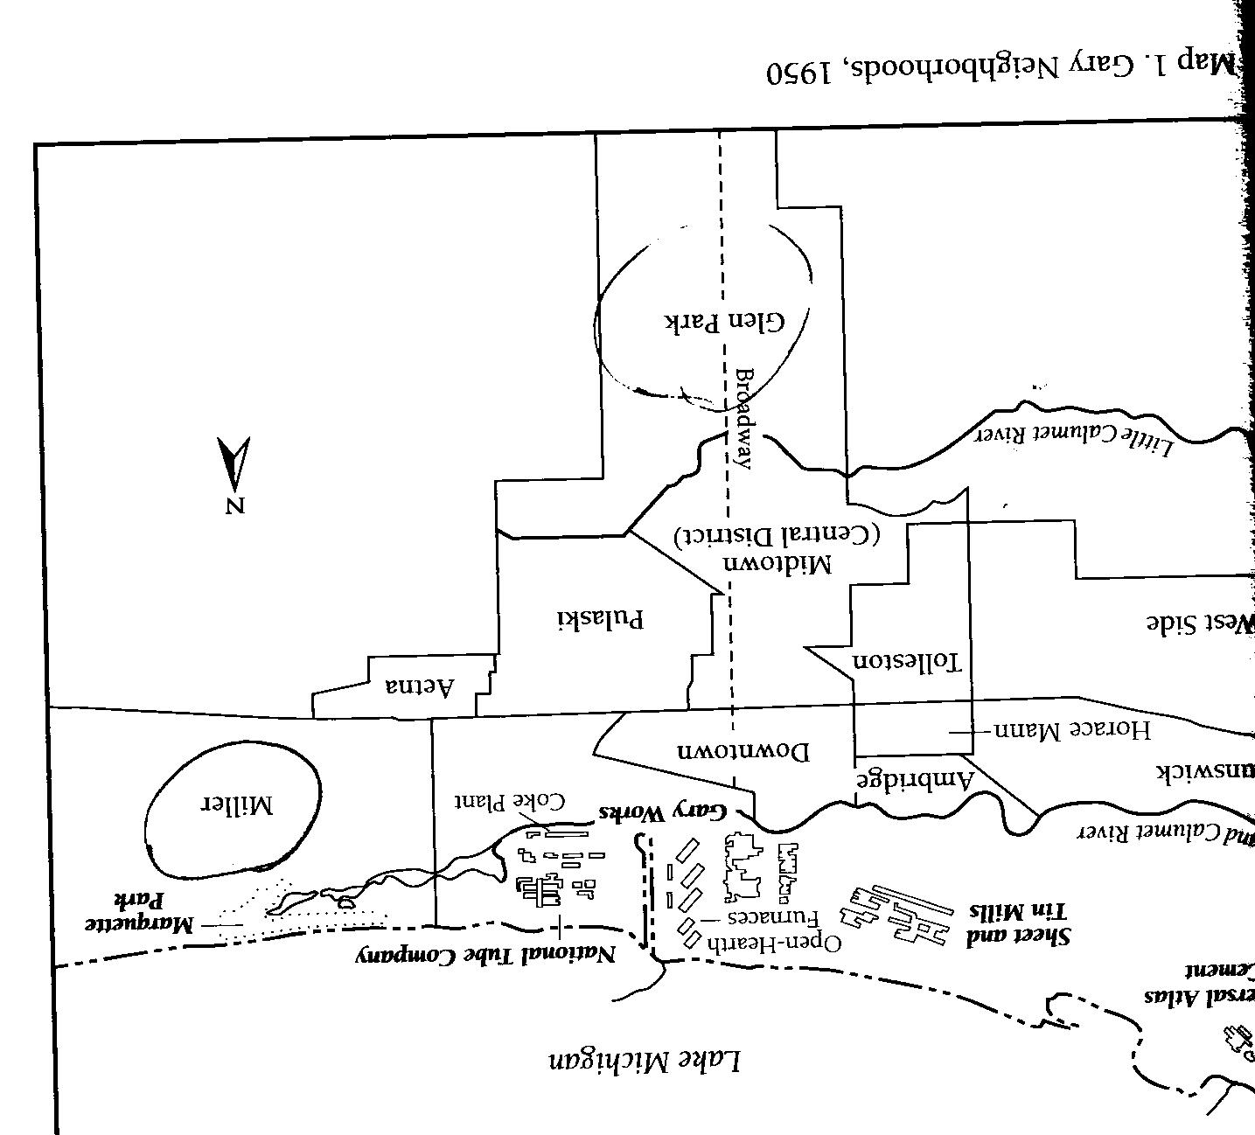
”Middle-class environmentalism” = Miller and Glen Park residents
Save the Dunes Council
”Working-class environmentalism” = Tolleston, West Side
Community Action to Reverse Pollution (CARP)

Slide 43
Save the Dunes Anniversary Video
Let’s look at this film as an artifact:
  How does it tell the history of environmentalism?
  What does it leave out?
https://www.youtube.com/watch?v=KLMv9lRbckw&feature=youtu.be

Slide 44
West side of the park

